Slide 1
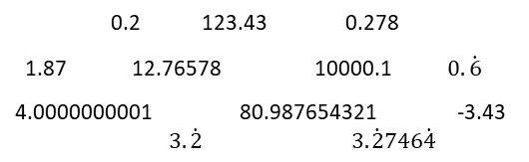
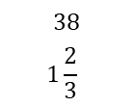
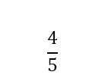
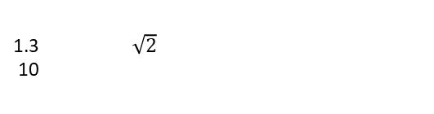
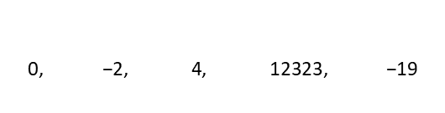
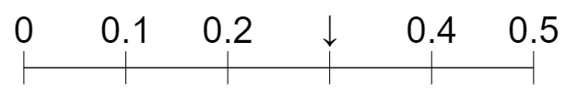

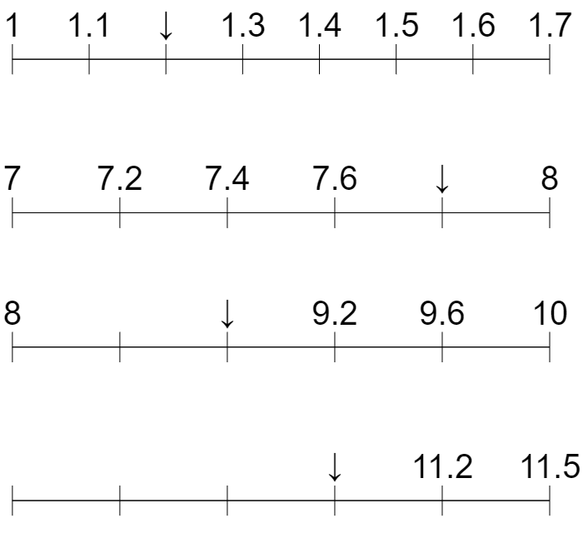

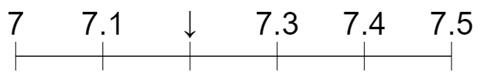

Subtopic N1.11 – Position Decimals on a Number Line
LEARNING OUTCOME: To position decimals on a number line
Objectives:
Keywords:
Decimal
Integer
Interval
Difference
To position decimals on a number line.
To work out intervals on a number line for decimals.
To complete number lines with decimal intervals.
Introduction – Read and annotate:
You will now build on your knowledge of integers on number lines, exploring where numbers with
parts less than one sit in relation to whole numbers and each other. This will develop your ability to
estimate exact positions between marked values and sets up rounding decimals in the next section.
Definition
Characteristics
A decimal is a number that is not whole, as it lies between whole numbers.
The whole and fraction parts are separated by a point called the decimal point.
Can be terminating or recurring.
Examples
Decimal
Non - Examples
240
Completing number lines and calculating midpoints
Steps | Look at the increments that the scale is increasing by. Use this to complete the number line. To find the midpoint, add the two numbers together and divide by two.
Example 1 – I do Fill in the missing values on the number line. The arrow indicates the midpoint of two values. Calculate this.
Example 2 – We do Fill in the missing values on the number line. The arrow indicates the midpoint of two values. Calculate this.
Example 3 – You do Fill in the missing values on the number line. The arrow indicates the midpoint of two values. Calculate this.
0.3
10.15
0.15
10.075
7.8
20.05
7.5
20.125
7.2
5.0
7.35
4.3

Slide 2
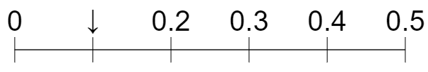
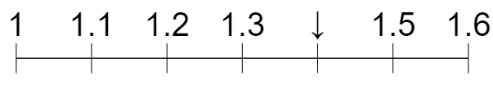

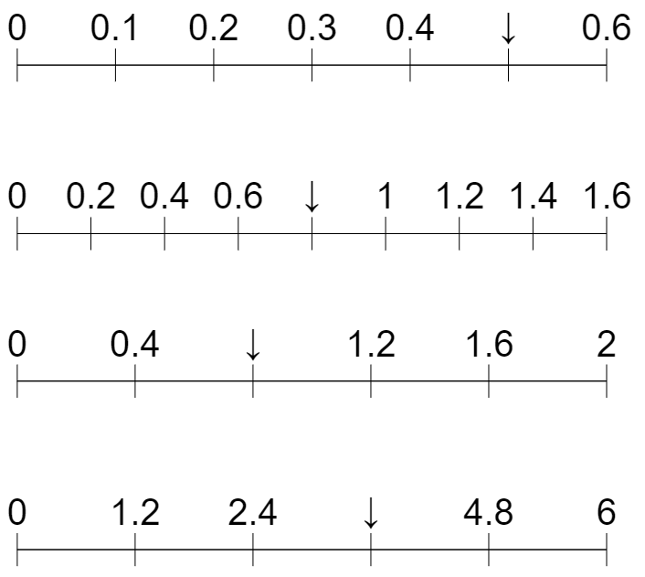

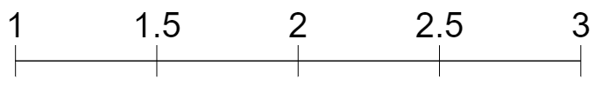
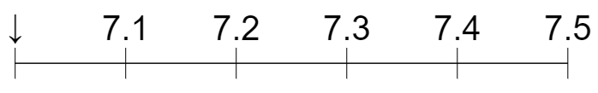
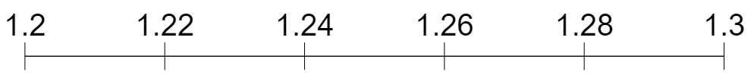





Independent Practice
Question 1. Fill in the missing values on the number line and calculate the midpoint of the two values either side of the arrow.
a) | b)
c) | d)
e) | f)
g) | h)
i) | j)
k) | l)
m) | n)
o) | p)
1.4
0.1
0.25
1.15
0.4
0.5
0.35
0.35
1.2
4.5
1.45
4.05
7.8
0.8
7.3
0.5
7
2.25
7.35
1.28
30.2
1.23
30.125
3.22
3.245
3.3
3.31
1.725
1.95
1.275
1.3125

Slide 3
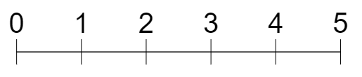
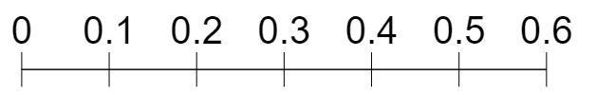

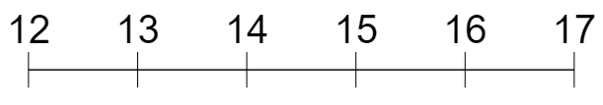


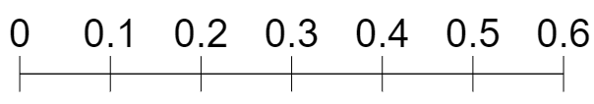

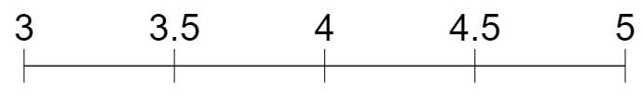

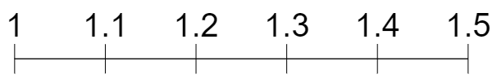
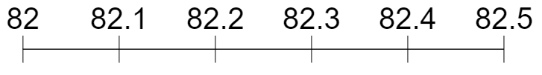
Estimate, label and draw decimals on number lines
Example 4 - I do…
Example 5 – We do…
Example 6 – You do…
Steps | Mark with an arrow: | Mark with an arrow: | Mark with an arrow:
1) Identify the two values on the number line that the number we are estimating lies between. 2) Consider the midpoint. Will the value we are estimating be above or below this? | 1.6 0.16 1.2 9.9 | 4.6 0.44 3.9 13.2 | 3.4 0.34 2.1 31.9
Independent Practice
Question 2. Label the arrows with estimated values, then mark an arrow to estimate the given value.
1.4
0.14
a) 1.4 | b) 0.14
c) 6.3 | d) 4.4
e) 17.05 | f) 1.37
g) 82.45 | h) 20.45
0.3
3.7
0.29
0.51
6.3
4.4
4.2
5.8
3.6
4.6
17.05
1.37
17.35
17.82
1.13
1.26
82.45
20.45
8.22
8.47
20.05
20.58
‹#›

Slide 4
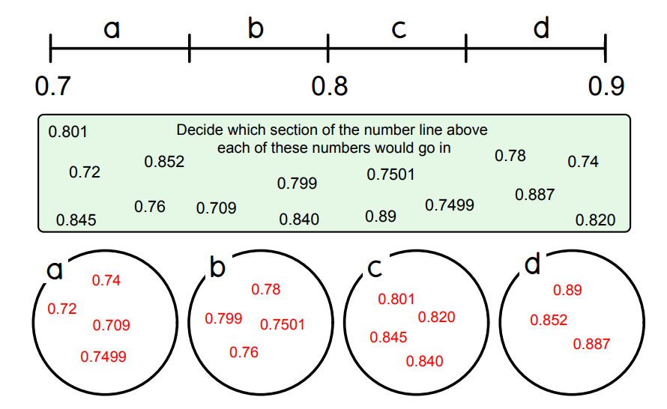
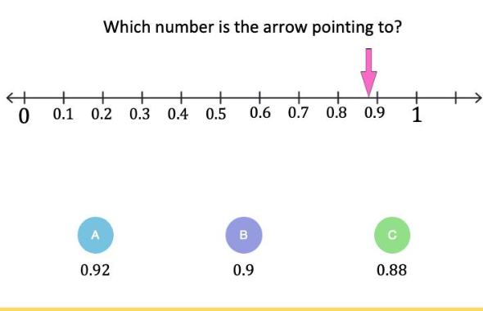
Question 3. Decide which section of the number line each of these numbers would go in:
0.801 0.72 0.852 0.799 0.7501 0.78 0.74 0.845 0.76 0.709 0.840 0.89 0.7499 0.887 0.820
Would go in section a | Would go in section b | Would go in section c | Would go in section d
Skills Check

